Slide 1


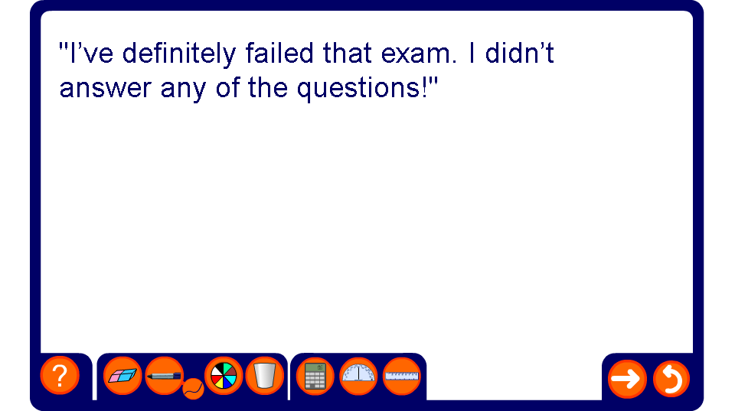


The language of probability
Notes:
Discuss the statements. Which ones do you agree with and why or why not? Pupils might be interested to know that a coin landing on its edge has been known to happen - the probability is so low as to make it negligible when calculating the probabilities of landing on heads or tails, however. Pupils may enjoy finding exceptions to the statement, for instance making up scenarios to show that eating when you get home is not certain or that it could snow in June. (You could ask them to research this as a homework task.)

Slide 2
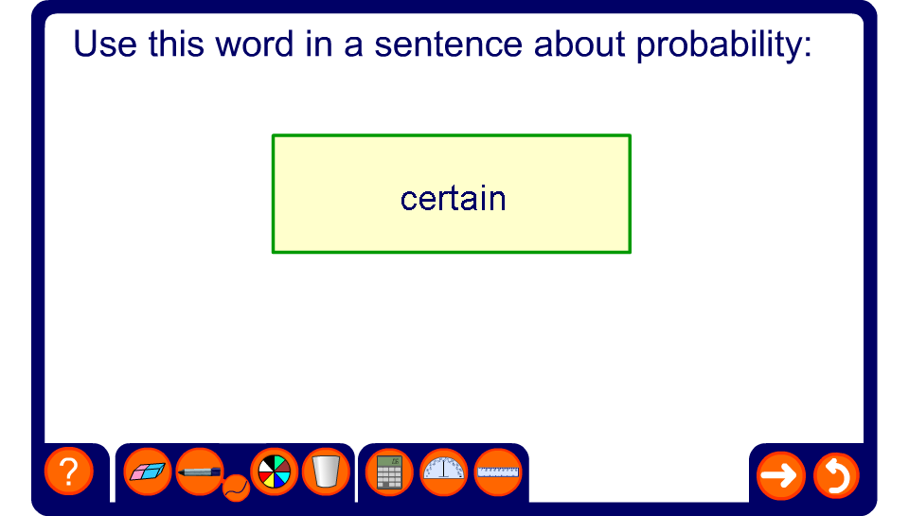
The language of probability race
Notes:
Make up a sentence using each word. This could be done as a competition: each team has 10 seconds to come up with a sentence. Bonus points can be awarded for humour.

